Slide 1
When: Tuesday 28th May from 11am-1pm Where: Ellesmere Primary School Pool (SY12 9EU) Outline: 10.45-11.00am Pre-Pool & Briefing 11.00am-1.00pm Water Session based on Freestyle Stroke Progressions, dives and turns with World Junior and European Junior Champion and Commonwealth and European Medallist FREYA ANDERSON. COST: £50 (£25 NON REFUNDABLE DEPOSIT REQUIRED TO SECURE SPACE), BALANCE DUE BY MONDAY 20TH MAY HOW TO BOOK: Email Steffi Bircher (steffibircher@gmail.com) to book your space(s) for County to Regional level swimmers born between (including) 2009 - 2004 . Spaces are limited, so book early to avoid disappointment!
Freestyle, dives and turns Master class
with former international swimmers

Slide 2
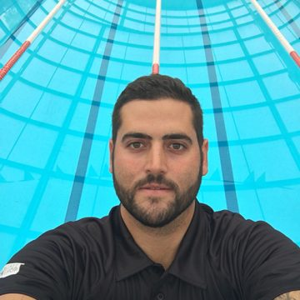
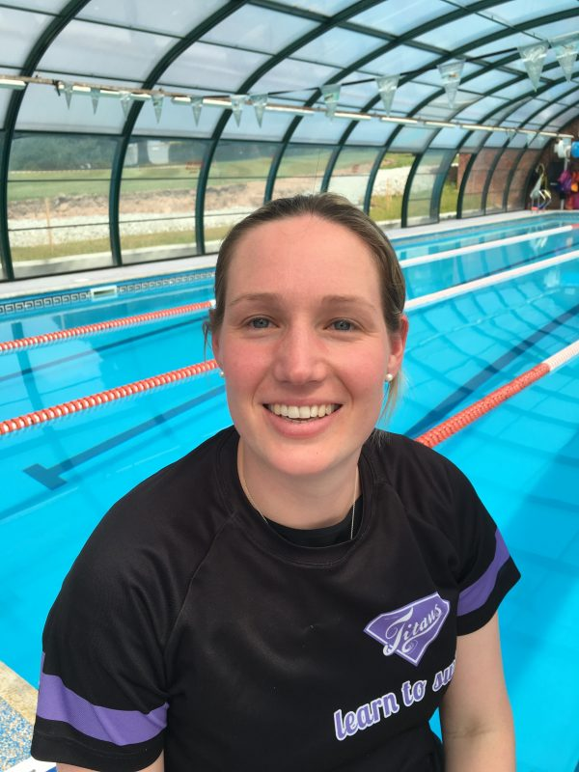
Coaches:
Alan Bircher
Swimming Background
GBR International Swimmer 1997-2008
World & European Silver Medallist
Multiple World Cup Stage Winner
Double European Cup Champion
10 Time British Champion
Coaching Background
European Championships Champion
Commonwealth Games Medallist
World junior Championships Champion
European Junior Championships Champions
World junior Open Water Medallist’s
European Junior Open Water Medallists
European Youth Olympic Medallist’s
Commonwealth Youth Games Medallist’s
BSCA Youth Coach of the Year 2016
GBR European Juniors 2016
GBR Texas Team 2016
GBR Coach European Championships 2014 & 2018
German Team Coach World Championships 2009
Multiple National Champions & Medallists
Stefanie Bircher
Swimming Background
World Championships Team Gold 2004
European Championships Silver 2004
European Championships Bronze 2006
Multiple World Cup Stage Winner
Double European Cup Champion
European Junior Champion 2003
5 Time German Champion
Coaching Background
England Talent Coach
Coached Multiple National Champions and Medallists
Developed some of Britain’s top Age Group swimmers
Developed some of Britain’s top Age Group Open Water swimmers
Diverse in coaching from Stage 1 LTS through to National Champions

